Slide 1
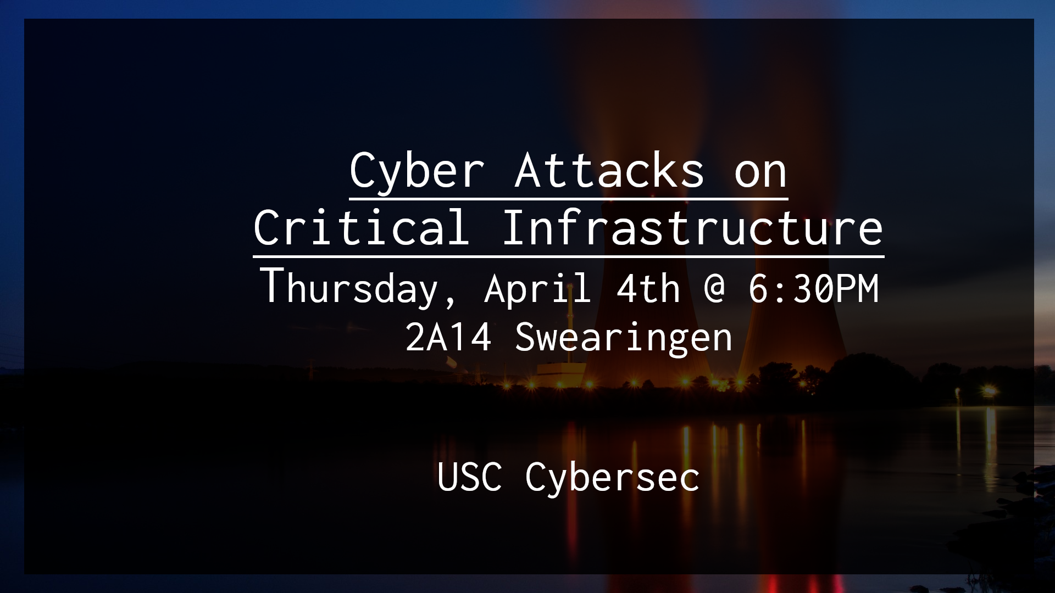

Slide 2


Slide 3
A Brief History of Iran’s Nuclear Program
The United States and Iran used to be good pals under the authoritarian reign of the Shah
Nixon Administration really wanted Iran to have nuclear power so we gave them centrifuges
Iran overthrew its government in the Islamic Revolution of 1979 and put in place leaders we didn’t like.
US responded by banning the sale of goods surrounding the uranium enrichment process to Iran.
US also convinced the rest of the world to get on board.

Slide 4
The Khan Network
A.Q. Khan was a Pakistani nuclear physicist and metallurgical engineer who ran Pakistan’s nuclear enrichment program from 1976 until 2001.
Was responsible for Pakistan obtaining nuclear weapons
Sold nuclear technologies to Iran, North Korea, Libya, and China
This was during the nuclear embargo the United States imposed on Iran

Slide 5
Escalating Tensions
After United States invasion of Iraq, Iran became very concerned with US invasion.
From 2003 - 2005, Iran adopted a International Atomic Energy Agency (IAEA) resolution to suspend all uranium enrichment activities.
Iran slowed the program, but failed to co-operate with IAEA inspectors
Around 2005, Iran began to ramp their program back up as they no longer feared US invasion
In December of 2006, Netanyahu had a press conference where he took a hardline stance against Iran
Behind the scenes, Israel was talking to the United States about potentially bombing Iran
Notes:
https://www.armscontrol.org/factsheet/Timeline-of-Nuclear-Diplomacy-With-Iran

Slide 6
Escalating Tensions
Bush Administration was under the impression that if Israel attacked Iran, they would expect the United States to back them up due to their limited air capabilities
As an alternative, US and Israeli Intelligence worked out a plan to conduct Cyber attacks on the Natanz nuclear enrichment facility in Iran
Operation would involve the CIA, the US Cyber Command, and the NSA
Program would be codenamed “Operation Olympic Games”
Interesting fact about the NSA: The NSA isn’t authorized to carry out offensive cyber missions. The US Cyber Command, one of the commands under the DoD, is. NSA conducts cyber attacks and the US Cyber Command takes the flack for it.
Notes:
Israeli Fears

Slide 7
The Discovery of Stuxnet
In July, 2010, a security company in Belarus named VirusBlokAda discovered a piece of malware like they had never seen before when working with a client in Iran
Brian Krebs would be the first major public figure to make a post on the malware, named “Experts Warn of New Windows Shortcut Flaw” after reading Sergey Ulasen of VirusBlokAda’s advisory on the malware.
The name Stuxnet would be coined by Symantec researchers, combining the names of the mrxnet.sys kernel space rootkit and the .stub section in the main dropper for the malware that contained the main DLL for Stuxnet as well all the necessary configuration information
Wouldn’t be until Liam O Murchu of Symantec began seriously looking into Stuxnet would they realize what a hell of virus it was.
Notes:
Krebs just thought it was a typical windows zero day
http://krebsonsecurity.com/2010/07/experts-warn-of-new-windows-shortcut-flaw/
https://www.codeproject.com/Articles/246545/Stuxnet-Malware-Analysis-Paper

Slide 8
The Discovery of Stuxnet
Initially, O Murchu had handed the virus off to an engineer with no experience with zero days thinking it would be a good training exercise.
O Murchu kept looking at the code himself though, realizing that it was incredibly dense to not contain any images, to just be all code.
Was around 500K when most of the malware they saw was 10k-15k
O Murchu realized that the virus was going to incredible lengths to hide itself, loading it’s decrypted payload into a virtual file in memory. It then reprogrammed the Windows API so that whenever it was called, it would be loaded from that virtual file rather than from disk, making sure the decrypted code would never touch disk, effectively hiding itself from AV.
Up until this point, O Murch hadn’t seen anything like it
Notes:
https://arstechnica.com/tech-policy/2011/07/how-digital-detectives-deciphered-stuxnet-the-most-menacing-malware-in-history/2/

Slide 9
The Discovery of Stuxnet
This was all within the first 5k of code. O Murch still had 500K lines of code left.
Would hand the investigation off to Symantec Tokyo for the weekend and pick the investigation the following week
Over the next week, Symantec would determine that the Stuxnet virus was phoning home to www.todaysfutbol.com and www.mypremierfutbol.com
Symantec convinced the DNS providers for these sites to reroute traffic to a Symantec controlled sinkhole where they could log ip addresses and requests.
The requests contained a few pieces of information: External and internal ip addresses, os versions, and whether or not the systems had Simatic WinCC and Simatic Step 7 installed on them.

Slide 10
The Discovery of Stuxnet
SIMATIC WinCC is a supervisory control and data acquisition (SCADA) and human-machine interface (HMI) system from Siemens. SCADA systems are used to monitor and control physical processes involved in industry and infrastructure on a large scale and over long distances. SIMATIC WinCC can be used in combination with Siemens controllers. - Wikipedia
SIMATIC Step7 is a piece of software used to interface with PLCs, or Programmable Logic Controllers.
Programmable Logic Controllers are small computers that interface with industrial systems, and serve various functions such as controlling pressure levels, controlling engine speed, or any other manipulation of an industrial system that you might need to do.
SCADA software is designed to interface with lots of PLCs and RTUs

Slide 11
The Discovery of Stuxnet
Over the next few days, Symantec’s sinkhole would be connected to by over 100,000 unique clients.
The majority of the infected computers were coming from Iran. This was unheard of as the majority of attacks were centered in countries like China and the United States
It was obvious that the malware originated from Iran
Symantec discovered that the virus was carrying a whopping 4 zero days. In comparison, Symantec would only encounter a handful more zero days over the entire year.
What’s a zero day? Exploit code that is only known by its creator. Has an extremely high likelihood of infecting the target system because target system doesn’t even know it exists.
Notes:
Burning 4 days at once was absurd

Slide 12
The Discovery of Stuxnet
Burning 4 zero days was crazy
It was also evident that the virus was spreading only on local networks and via USB, which meant the target was air gapped.
The malware also contained two stolen certificates for signing device drivers from Realtek and JMicron, two Taiwanese companies with headquarters located within walking distance of each other. These stolen certificates were used to sign the rootkit contained within the malware so they could install without alerting the end-user.
All these factors and more made the team at Symantec realize they were onto something enormous

Slide 13
The Discovery of Stuxnet
Problem: No one at Symantec knew STL, the programming language used to communicate with the PLCs. They also didn’t know much about how PLCs operated.
Enter Ralph Langner, a German Computer Security and Industrial Control System Expert
Worked at a 3 man company that specialized in Siemen’s Industrial Control Systems
Had been following along with Symantec’s online publications on the virus and began to become concerned that his clients would be targeted by the virus
Reached out to Symantec and began investigating the virus along side them
Realized that the target of the code was Nuclear Facilities

Slide 14
The Discovery of Stuxnet
Langner would begin going to closed door conferences talking about his discoveries
Was absolutely convinced that the Stuxnet virus was designed to attack the Bushehr Nuclear Power Plant in Iran
This was just a working theory, and Symantec had yet to back this up
People thought he was out of his mind
However, Symantec realized that certain magic number values in the code referenced specific centrifuge models, the same centrifuges that were in use in the Iranian Nuclear facility
Analysing images from the Natanz plant, Ralph Langner realized that there was a correlation between the number of centrifuges and cascades at the Natanz plant and specific data structures in the code

Slide 15
The Discovery of Stuxnet
Symantec realized that the Stuxnet virus targeted 5 specific contractors that worked on-site at the Natanz facility
Stuxnet virus appeared to implant itself on USB devices and local laptops.
Once it discovered its host system was connected to a specific model of PLC in a specific location, it injected itself onto the PLC and it was game time.
Multiple variants
Initial version manipulated pressure valves. This would crack the centrifuges as they had to operate at a very specific pressure.
This version didn’t do enough damage, so later version much more aggressive, and spun centrifuges up and down.
Inside sources at the NSA claimed Unit 8200, Israel’s equivalent program, made the changes that caused the virus to infect outside computers

Slide 16
The Impact of Stuxnet
Initially, there were lots of centrifuges blowing up
Estimated that the program got slowed down maybe a year at the most
2 Scientists from the Natanz plant were assassinated
While there was an initial dip in operational centrifuges, after 2012, that number skyrocketed.
Caused Iran to form the Iranian Cyber Army, the 4th largest cyber unit in the world
Retaliated with multiple attacks, notably an attack against the Saudi Aramco oil company with malware that wiped the drives of 30,000 computers
Also conducted massive denial-of-service attacks against banking institutions such as Bank of America and Wells Fargo.
In those banking attacks, multi-million dollar losses
Notes:
https://www.newsweek.com/irans-cyber-warfare-program-now-major-threat-united-states-745427

Slide 17
The Impact of Stuxnet
What’s important isn’t the damage caused to the Iranian nuclear program, but rather what it means for cyberwarfare
This was a new type of virus that was never seen before.
Stuxnet set the bar at a new level, showing other nations what was possible
Emboldened other nations: If the United States can do it, so can we

Slide 18
Nitro Zeus
During the documentary Zero Days, NSA insiders informed interviewer that Operation Olympic Games was actually part of a much bigger program called Nitro Zeus
Nitro Zeus was the United State’s response plan in case Israel actually attacked Iran
Essentially, the United States had infected all critical infrastructure in Iran, enabling them to disrupt Iranian communications, power systems, water purification systems, the whole bag
If the claims are true, this means that the United States could flip a switch and turn the lights off in Iran

Slide 19
Ukrainian Blackouts
In December of 2015, Ukraine would suffer a massive blackout lasting 6 hours that took down 30 substations
Happened almost instantaneously
Blackout left technicians scrambling to figure out what had happened
Appeared to be a cyber attack
The following year, Ukraine would suffer another smaller blackout in December. This followed the political revolution in Kiev and the annexing of Crimea by Russia
It was evident who was behind the attack.
These blackouts followed a significant amount of cyber attacks on businesses that would infect and wipe out their active directory controllers
Attacks also followed disinformation campaigns surrounding elections

Slide 20
Ukrainian Blackouts
Fear was not only was Russia trying to make Ukraine look like a failed state, it was also using it as target practice in order to carry out similar attacks on the west
If Russia has these capabilities in their back pocket to shut down entire regions of power grids, what can they do to the United States?
What can the United States do to other nations?
Massive ethical concern: If you shut down power grids, you have massive economic impact, and can potentially kill lots of civilians if the blackout is sustained.
Impact just as bad as physical warfare, but there aren’t many international norms surrounding cyber attacks

Slide 21
Close to Home
Significant concern that our industrial control systems are just as vulnerable
Operations on our grid largely automated
A significant attack could take down portions of the grid for days if not weeks
Our grid is harder to take down, but easier to keep down compared to the Ukrainian grid
Recently we were given a D+ rating in overall infrastructure by the American Society for Civil Engineers
United States aware of multiple hacking attempts at several industrial facilities
While only two groups, the Equation Group at the NSA and the Sandworm Group behind the attacks on Ukrainian Infrastructure have successfully disrupted operations, countries like Iran, North Korea, and China are rapidly gaining new capabilities
Notes:
North Korean attacks on banking infrastructure

Slide 22
What do we do?
Significant investments in Infrastructure Upgrades need to occur
A move away from centralized grid systems need to happen.
Instead a system of federated micro grids need to occur.
This means that if any portion of the grid shut down, it would impact the rest of the grid
Significant pushes to get the general public interested in cyber security need to happen. Way too many job openings for the number of qualified candidates
Need informed politicians who understand technology and can implement sane, research based policies
Need to get rid of the shroud of secrecy surrounding cyber capabilities. If we can discuss our nuclear capabilities, why can’t we discuss our cyber capabilities?

Slide 23
What do we do?

Slide 24
Questions

